Slide 1
Human-Inspired Crowd Dynamics Learning For Agent-Based Crowd Control
Dylan Santiago

Slide 2
Table of contents
01
02
03
04
Related Work
Relevant and similar work in the field and what are the current problems
Introduction
Reinforcement Learning, crowd simulation dynamics, and ML-Agents
Design and Method
My method and design ideology for a crowd simulation agent
Results and Conclusion
The accomplishments and failures of this research

Slide 3
01
Related Work
What is the relevant and similar work in this field? What does it currently lack?

Slide 4
Physics-Based and Deep Learning Models
Special Force Model
Symbolic Regression
Data-Driven
Inspired by the way real life special forces conduct missions
Infers model from data to avoid imposing prior assumptions
Trained on real world data
Training Data
Complexity
Computational Efficiency
Quality and quantity of training data is vital
With complex algorithms the complexity of the model increases which can prevent further modification
Investigating the evolution and consequences of urban development

Slide 5
Synthetic Crowd Simulation Data Generation
Crowd Diversity
Able to simulate diverse crowd social interactions like dancing and fighting
Data-Set Realism
Computational Resources
Synthetic data-sets often lack the capacity to capture more intricate and varied crowd behaviors
Creating synthetic data-sets requires a large amount of computational power

Slide 6
Data-Driven Model for Movement Prediction
Visual-Information-Driven
Algorithm that utilizes past social-visual information of a person to forecast their future velocities.
Adaptability
Unable to effectively replicate complex crowd simulation in diverse environments with varied geometric terrain

Slide 7
Deep RL for Crowd Evacuation
DBFED-Net
Human Modeled
Framework of double-branch feature extraction and their own decision network to model and process diverse types of environment factors
Agents take on aspects similar to how real humans make decisions leading to more realistic results
Training Data
As with all deep learning framework the quality and quantity of training data is vital to the models performance

Slide 8
Summary
Scalability
Adaptability
When attempting to scale their models for bigger simulations they encounter difficulties. Mostly because of the sheer complexity of their algorithms introduced.
Many of these models are inadequate or unable to accurately represent a diverse range of environmental simulations. They are highly reliant on the testing environment they are trained on.

Slide 9
02
Introduction
What are Neural Networks, Deep Reinforcement Learning, crowd simulation dynamics and how can we utilize ML-Agents toolkit

Slide 10
Machine Learning Frameworks
Neural Networks, at its root is just a bunch of matrices and vector. You can think of it as the brain of an entity. It assigns weights and biases to each connection. These weights and biases are adjusted each training iteration to effectively reduce the difference of mapping a series of inputs to outputs. From expected results to actual results.
Reinforcement Learning, fundamentally it involves training artificial agents to make sequential decisions in environments in order to maximize rewards. The agent observes the state of the environment, makes an action, then receives a reward. This basic loop allows the model to “learn” what actions are favorable and not favorable in order to make better more intelligent decisions.

Slide 11
Toolkit
ML-Agents, a toolkit designed for Unity game engine that integrates common ML algorithms and frameworks into the engine. Think of it as ML-Agents is to Unity as tensorflow is to python. It provides us with the basic foundation needed to create intelligent agents and focus on the design of the agent.

Slide 12
03
Design and Method
My implementation for a human-inspired crowd simulation agent, and design ideology

Slide 13
Human-Inspired Crowd Dynamics Learning
Real Human Decision-Making Process, taking a step back from common techniques. How can we model a human behavior? By taking inspiration from how real humans make decisions and attempting to replicate that process we can attempt to create a more realistic looking simulation.

Slide 14
Human Observation Perception
How do real humans observe their environments? By looking around of course. Most reinforcement learning architectures rely on tons of observation data, which can lead to loads of computational issues in the future, but we do not necessarily need all that data?
I constrain my observational data to two vital pieces of information, the agents target position and its current position. Sure we can gain some more precise movement with more observations but humans are not robotic, they do not necessarily take note of all observations in front of them.
The agent's complete an action from an ActionBuffer that is simply the output of the neural network that consists of a vector of size 2. The first element is the movement along the x while the second is the movement along the z axis.

Slide 15
Basic Navigation
Every human learns basic navigation as of apart of growing up. The first step is to effectively simulate basic navigational skills with our limited observational data.
Once agents have mastered basic movement we can incrementally introduce more complex environments, and transfer this skills to other similar tasks such as emergency evacuation.
The rewards within reinforcement learning guide the agent to making meaningful actions that lead closer to the goal.

Slide 16
More Complex Movement
Moving from one place to another does not look like a real human. We need to make some modification and add some additional parameters to guide the agent to looking more human.
First step is dynamic speed adjustment. Agent needs to adjust its speed when approaching obstacles or other agents. With acceleration and acceleration
By replicating the way humans perceive obstacles we can guide the agent to making more realistic behavior.
Utilizing dynamic raycasts we can scan the environment and make decisions based off its collision data.

Slide 17
Flocking
Flocking is birds have been studied for centuries. How is this similar to the way humans crowd within situations and how is it different?
Modifying the BOIDS algorithm from Craig Reynolds we can effectively simulate how real humans would crowd and form groups in a crowd.
Consisting of Alignment, Separation and Cohesion this algorithm dynamically adjust and guide agent movement to simulate a seemingly realistic crowd grouping as observed in real crowd.

Slide 18
Training
I utilize three main algorithms to train these agents: Proximal Policy Optimization, Proximal Online Contextual Actor-Critic, Soft Actor-Critic.
PPO, main focus of this algorithm is to prevent large disparities in policies which can destabilize training. This this specific instance, say some agents decide to rebel and do not ideal behaviors. Instead of just drastically updating the entire policy within training we can gradually adjust them, slowly guiding toward an ideal outcome. A drastic adjustment could lead to weird behaviors as observed in early training where agents just spinned around.
POCA, similar to PPO, but instead focuses on continuous action steps as we utilized within our agent. We can expect better results when training agents with this policy algorithm.
SAC, leveraging all the benefits of PPO and POCA this algorithm learns simultaneously from both a policy function and value function. This is especially good for environments with scarce rewards. Though with its increased complexity we can expect longer training times.

Slide 19

Concurrent Training

Slide 20
03
Results and Conclusion
What can we conclude from this research and experiments? What are the accomplishments and failures of this?

Slide 21
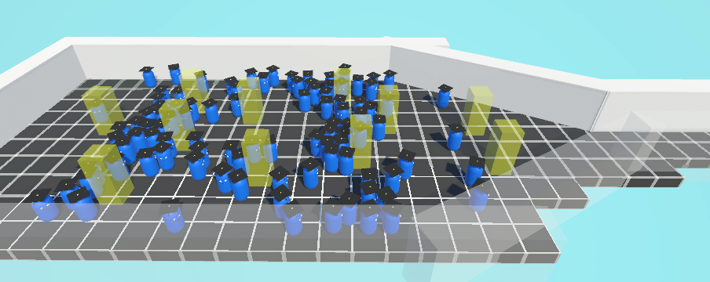
Environment Testing
Narrow Obstacles Environment

Slide 22
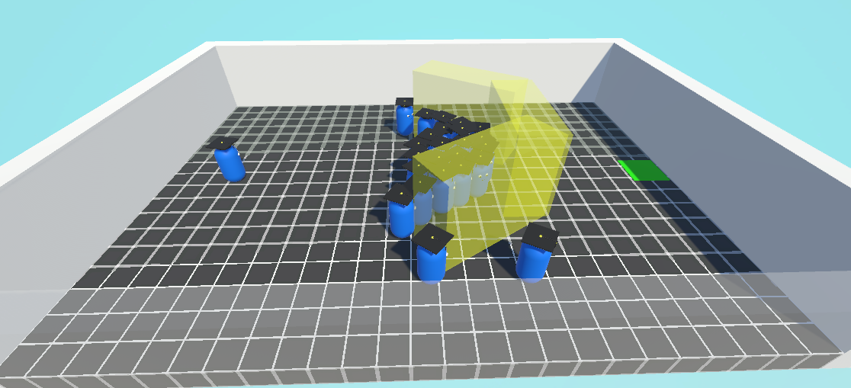
Environment Testing
Edge Case

Slide 23
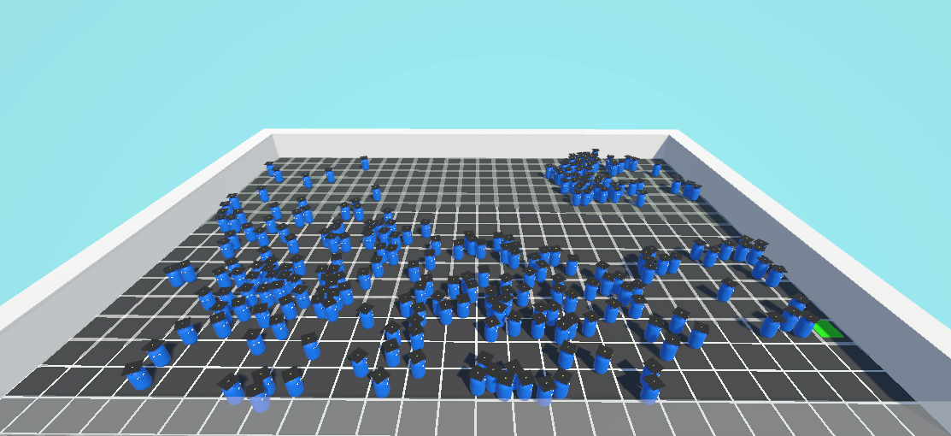
Environment Testing
Large Simulation

Slide 24
Conclusions
Quickly Adapt
Realism
Scalability
While this agent needs training for each environmental case it is able to very quickly adapt to each scenario and produce expected results
This model can effectively simulate simple crowd dynamics and behaviors observed in real life, while it does struggle to simulate more minute details
This model can be scaled to large environments and many agents. With a low input dimensionality it can be trained in a highly efficient manner. Though this model does slow down if a large amount of agents are loaded in very close proximity, 400+.

Slide 25
Thanks!
Do you have any questions?
youremail@freepik.com
+34 654 321 432
yourwebsite.com
Please keep this slide for attribution

